Slide 1
Coalesce Design
Seantel Trombly
And a (missing) Brian Sandford

Slide 2
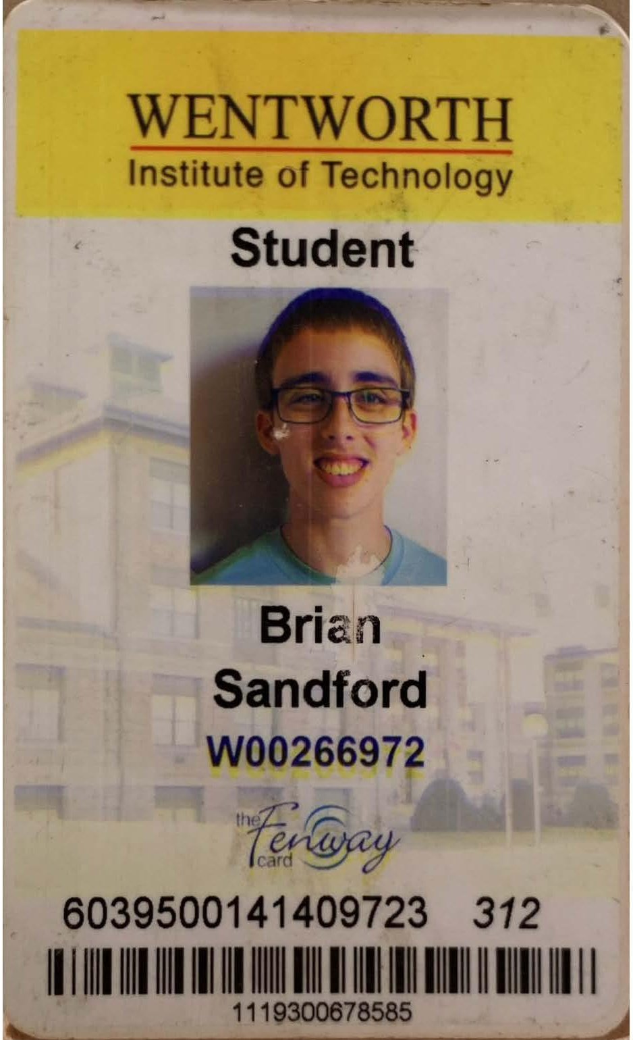
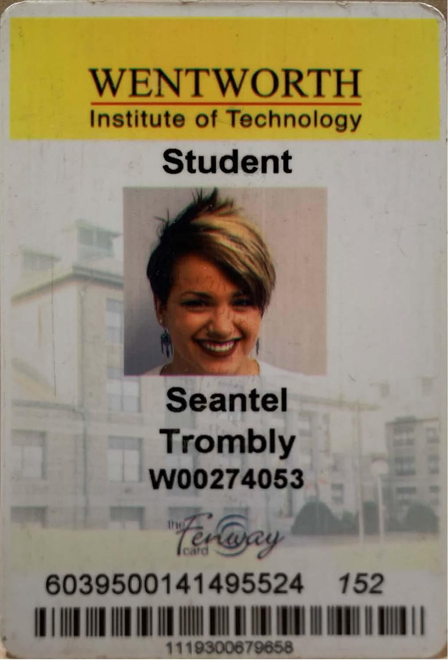
Notes:
I’m Seantel Trombly, an 2018 M.Arch grad, and that is my friend Brian Sandford, a fellow graduate, who unfortunately cannot be here today
We completed undergrad and masters together
Our theses both thought a lot about how non-architects perceived and experienced the built environment

Slide 3
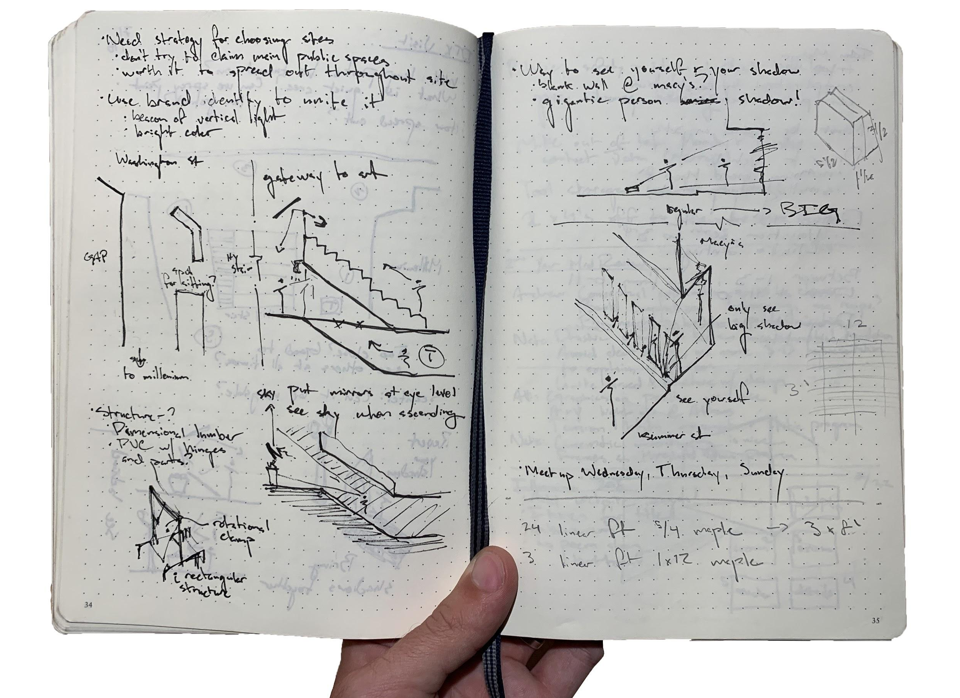
Notes:
After graduation, we wanted to keep the work going
Decided to get together once a week, with no clear goal in mind, besides a desire to push the topic forward
Worked through sketches, conversation, etc

Slide 4
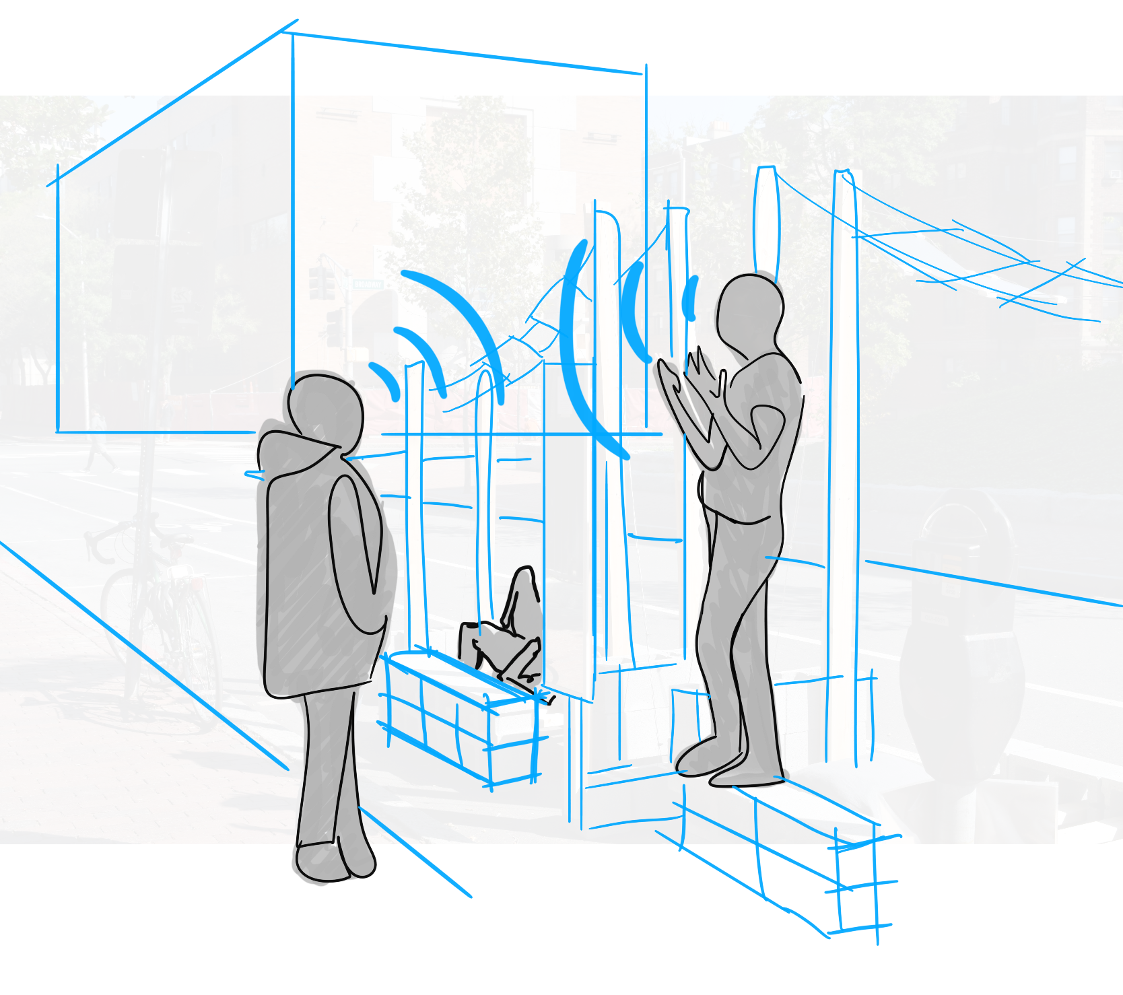
Notes:
Through this, a few basic tenents emerged:
People care about the quality of their built environment
People an innate knowledge about the quality and power of these spaces
People don’t know they have this knowledge
So we decided to start a podcast to teach people how to talk about the built environment

Slide 5
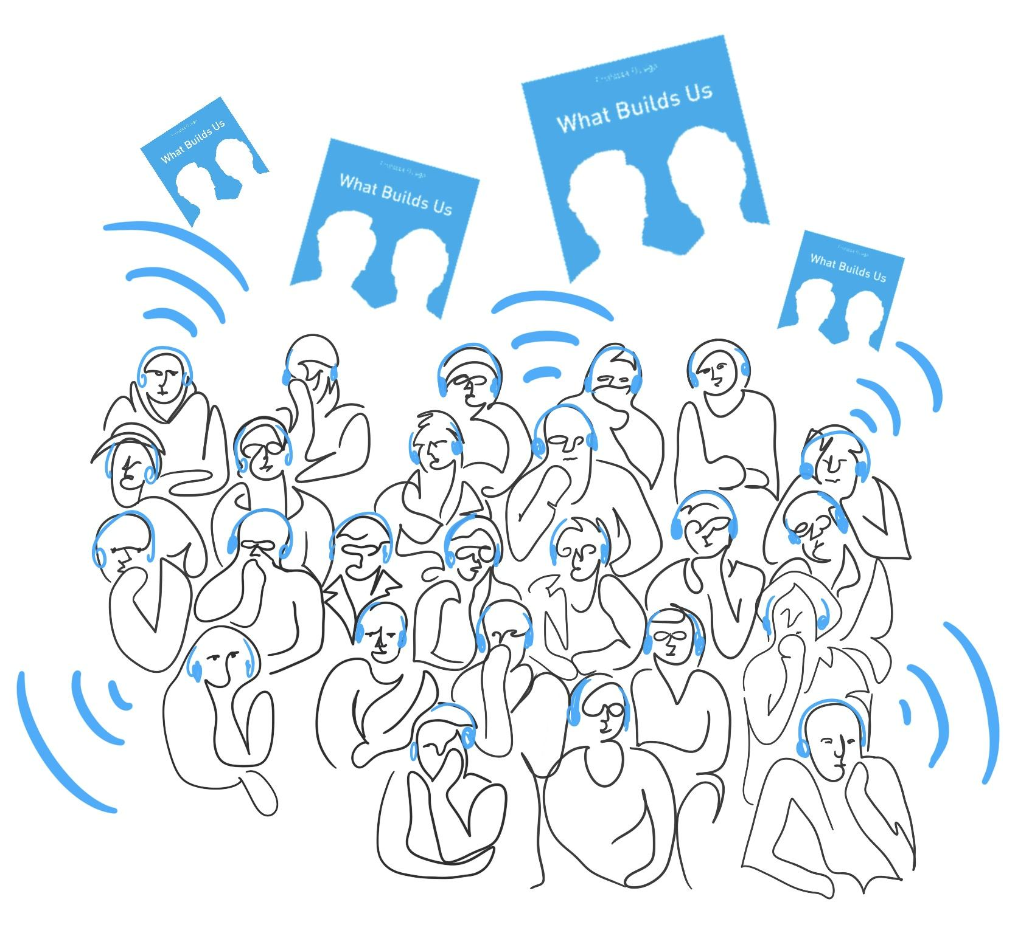
Notes:
The key to the show was to keep people engaged
Tone was very conversational, careful about vocabulary and terminology
Wanted to let people know Brian & I were learning with them

Slide 6
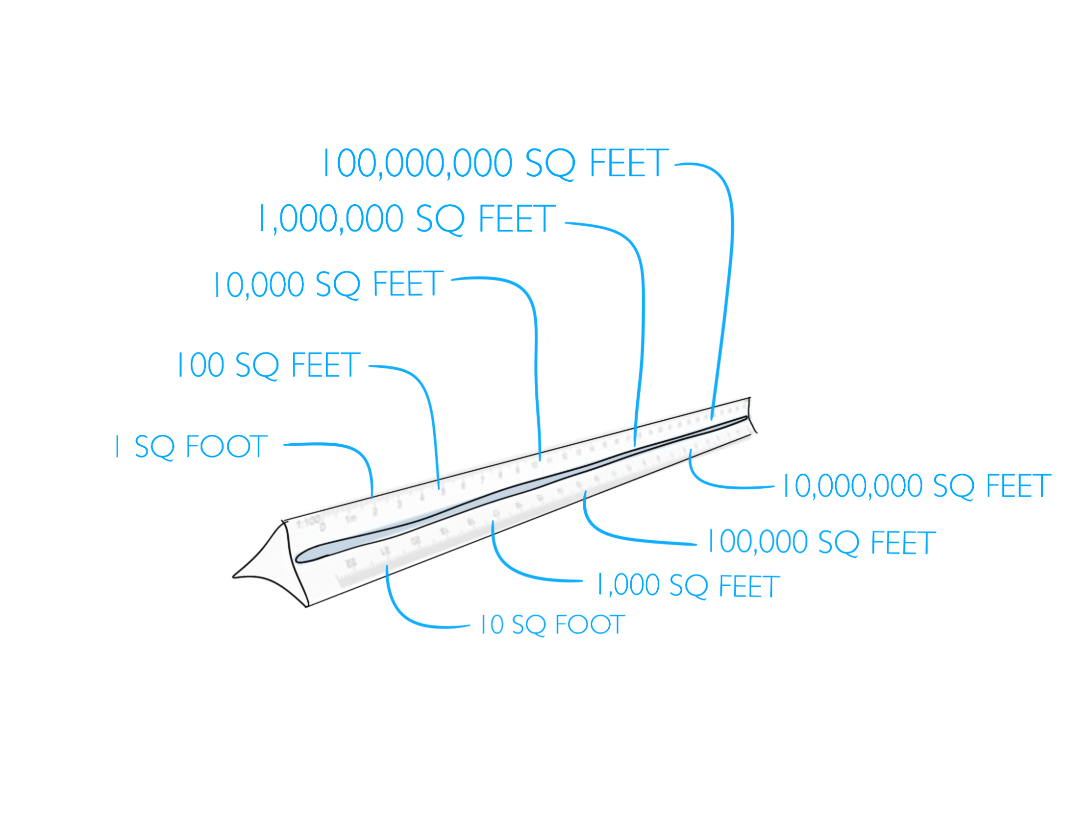
Notes:
Used this theme of scale to guide the journey, starting small and building up
Hope was that everyone could understand the dynamics of a simple area around their body
Then we could slowly move onto larger and more complex topics

Slide 7
Curating the Podcast!
Do’s
Dont’s
Diversity of Guests
Don’t be like other podcasts
Variety of Backgrounds
Don’t only Talk to Architects
Accessible Vocabulary
Designer Jargon
Engaging and Concise
Boring and Long-Winded
A journey
Have it feel like a class
Easy to Re-tell
Notes:
The show isn’t just Brian & I talking to each other, we have guests on almost every episode
Wanted a variety of guests from a variety of fields and topics
It was important to us that it wasn’t a bunch of old white dudes who studied architecture

Slide 8
`
Notes:
Want to run through a few key episodes to give you a feel of the show
Episode 1, 1 square foot, used to set the tone, structure, and overall concept
Clip of seantel stealing Brian’s identity

Slide 9
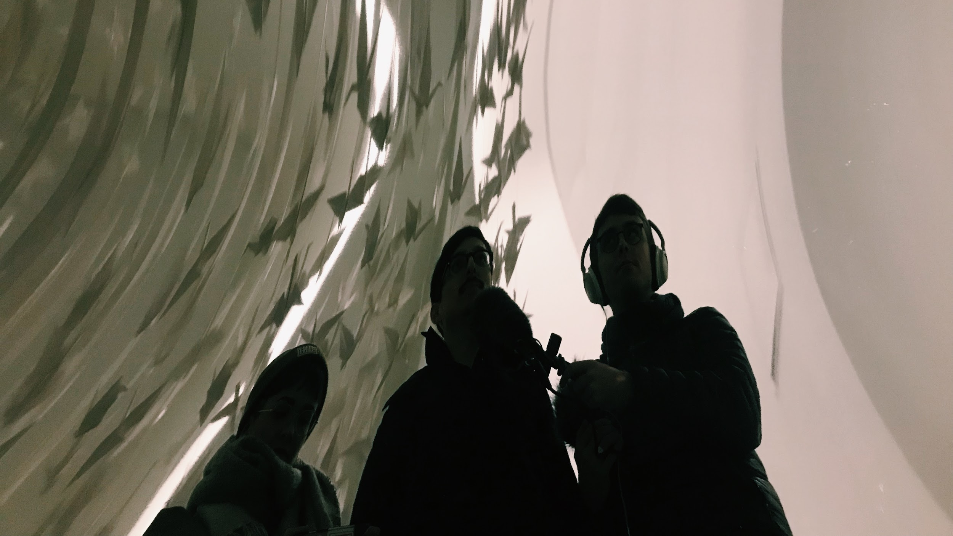
Notes:
Slowly moved up to Episode 5, 10,000 square feet, where we went out into the city with our friend and non-architect Ivan
Used his input as a sort of baseline as we toured three prototypical types of public interior spaces
Was a change from normal “studio” recording

Slide 10
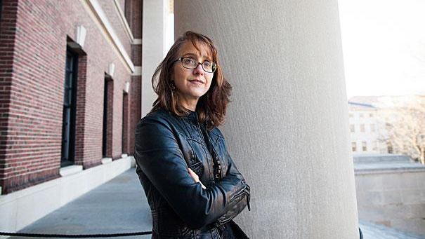
Notes:
Episode 9, 10,000,000 square feet, covered the influence of gender and race in our experience of space, so we spoke with Harvard Professor Caroline Light
Important to hear from a person with authority, who wasn’t an architect

Slide 11
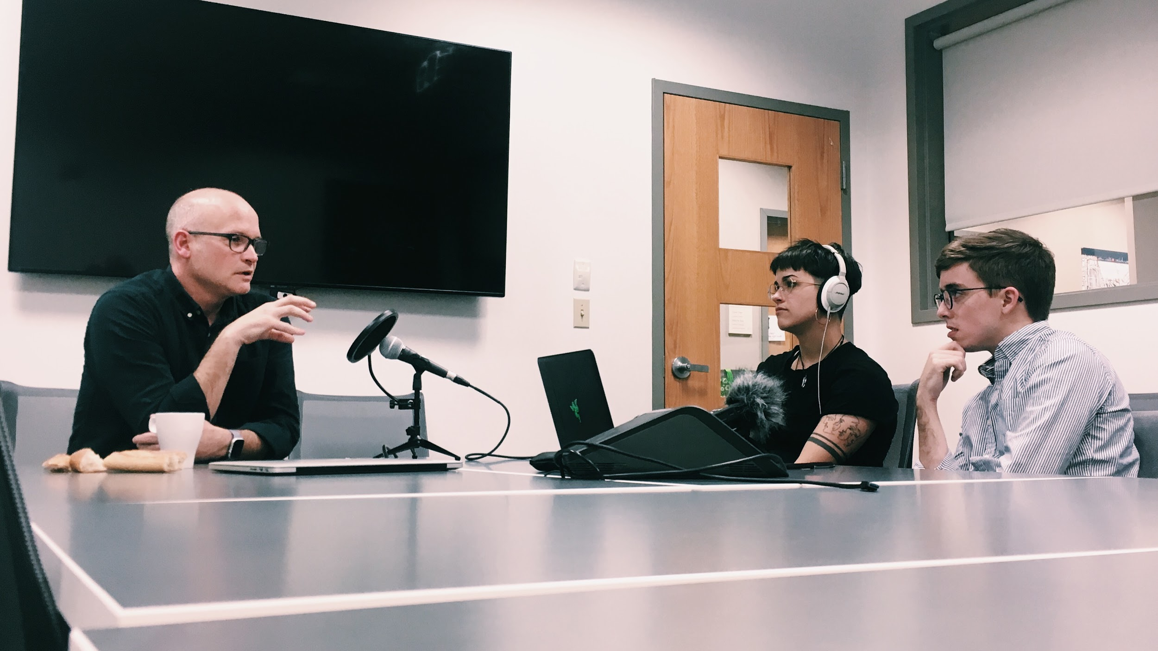
Notes:
We of course wanted to tap into our network at WIT, so we spoke with a few different professors, such as Anne-Catrin Schultz, John Ellis, and Rob Trumbour
All really generous with their time, and were really supportive, and let us tap into the community that we can connect to here

Slide 12
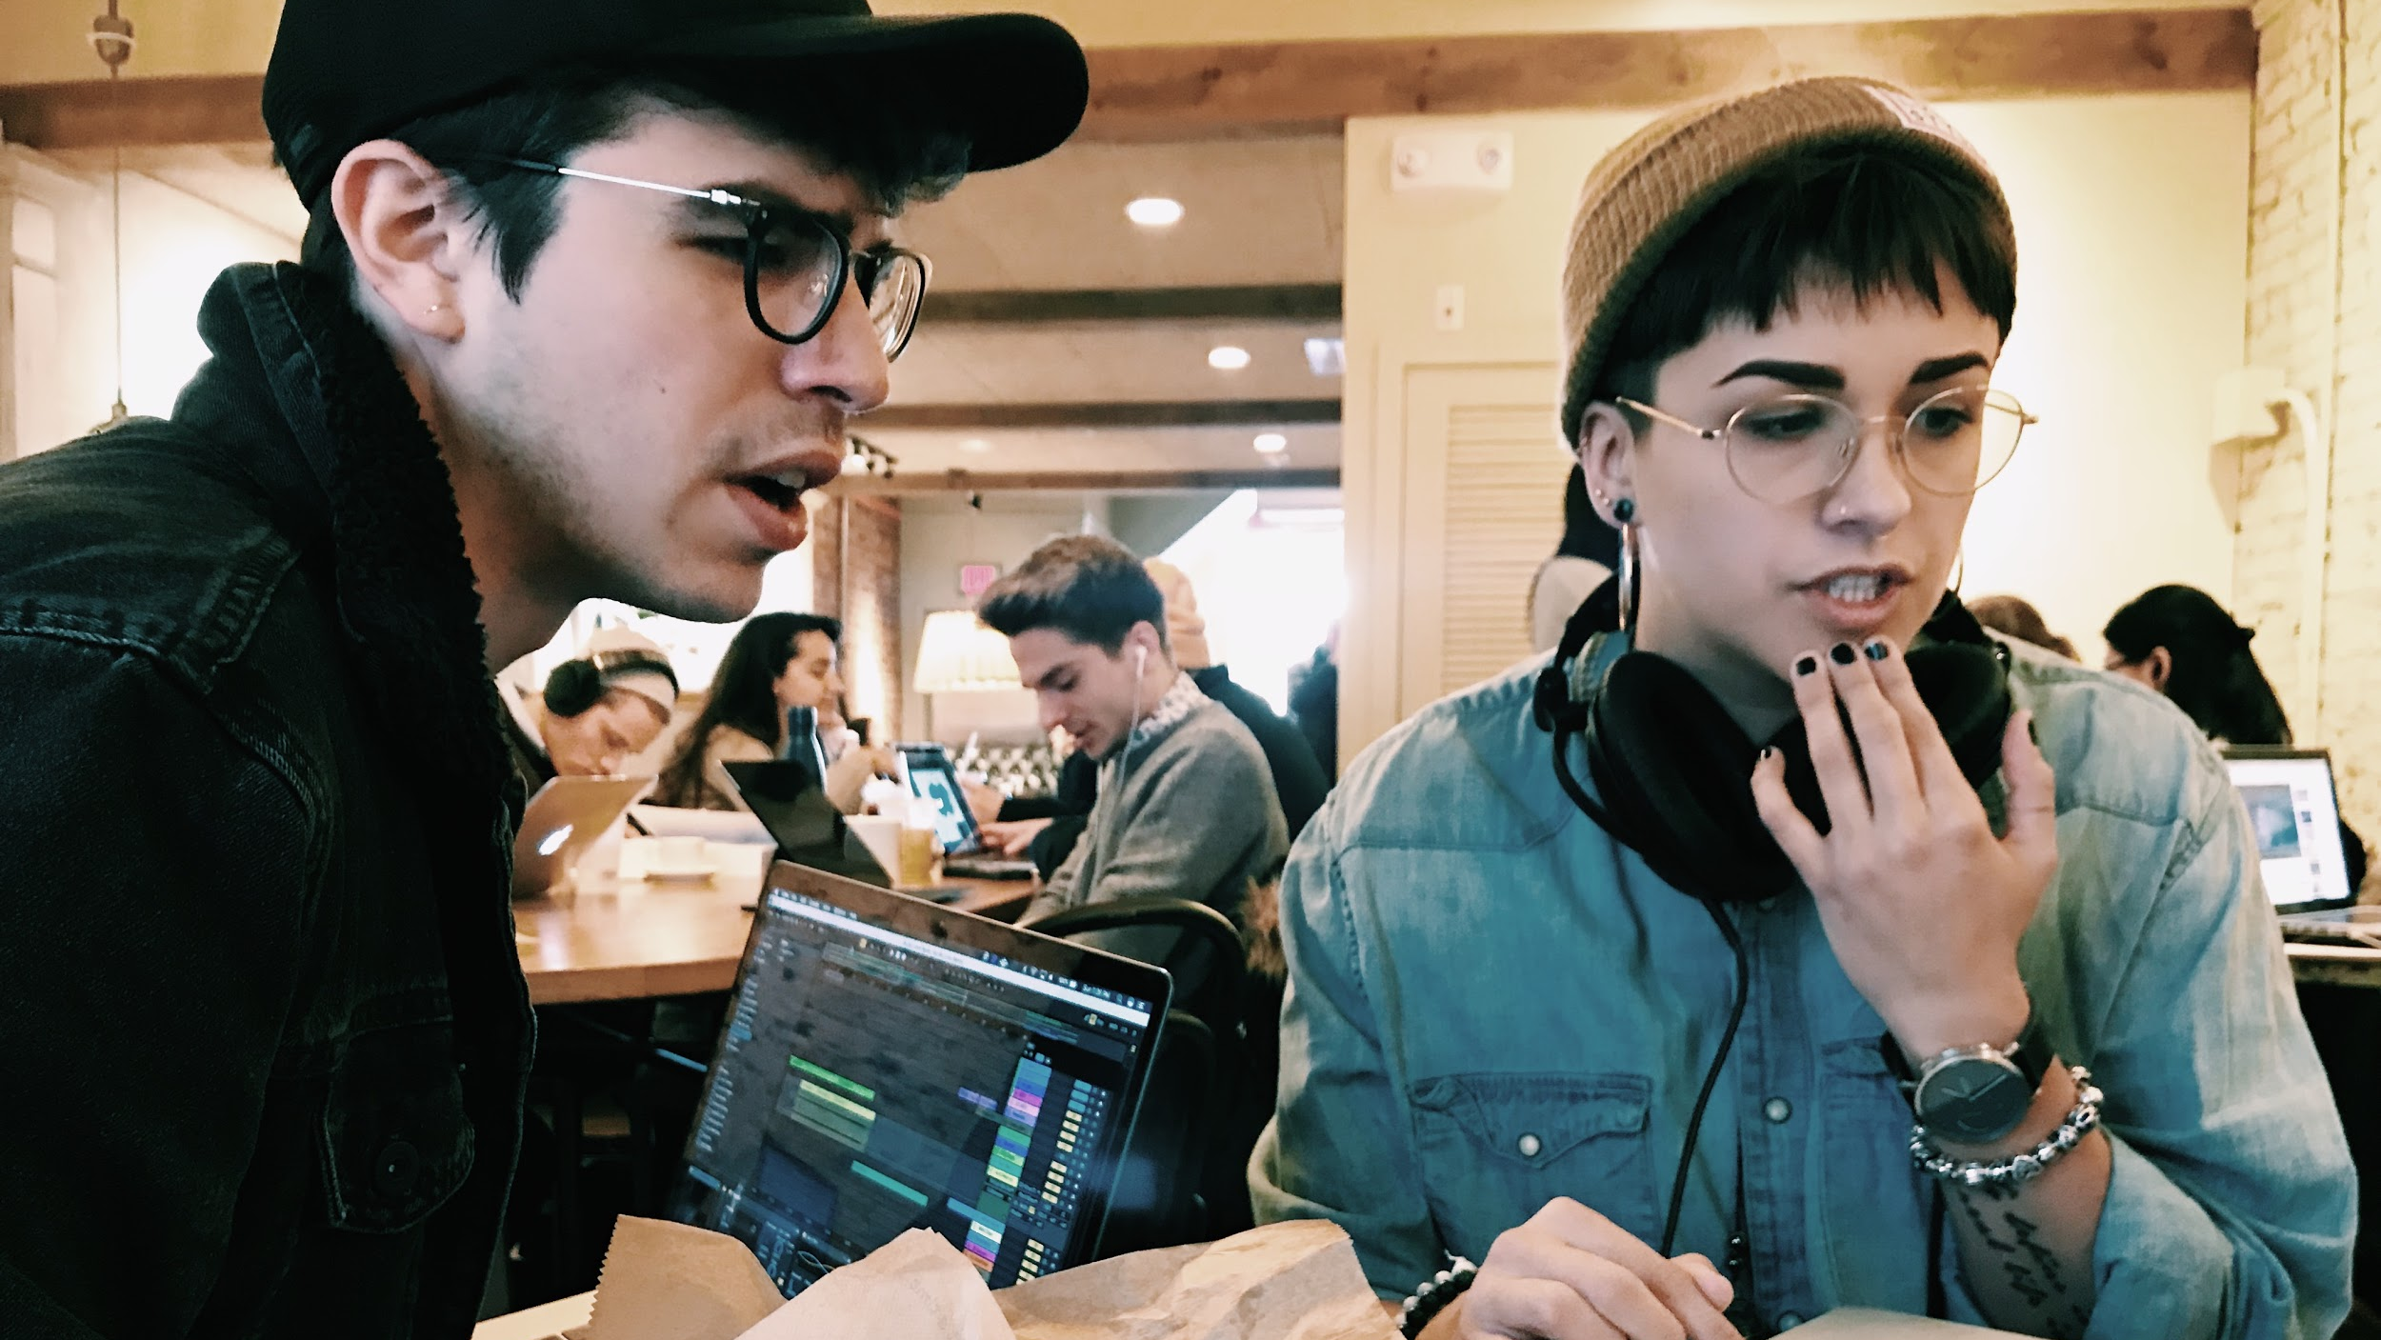
Notes:
Thorns / will gooding

Slide 13
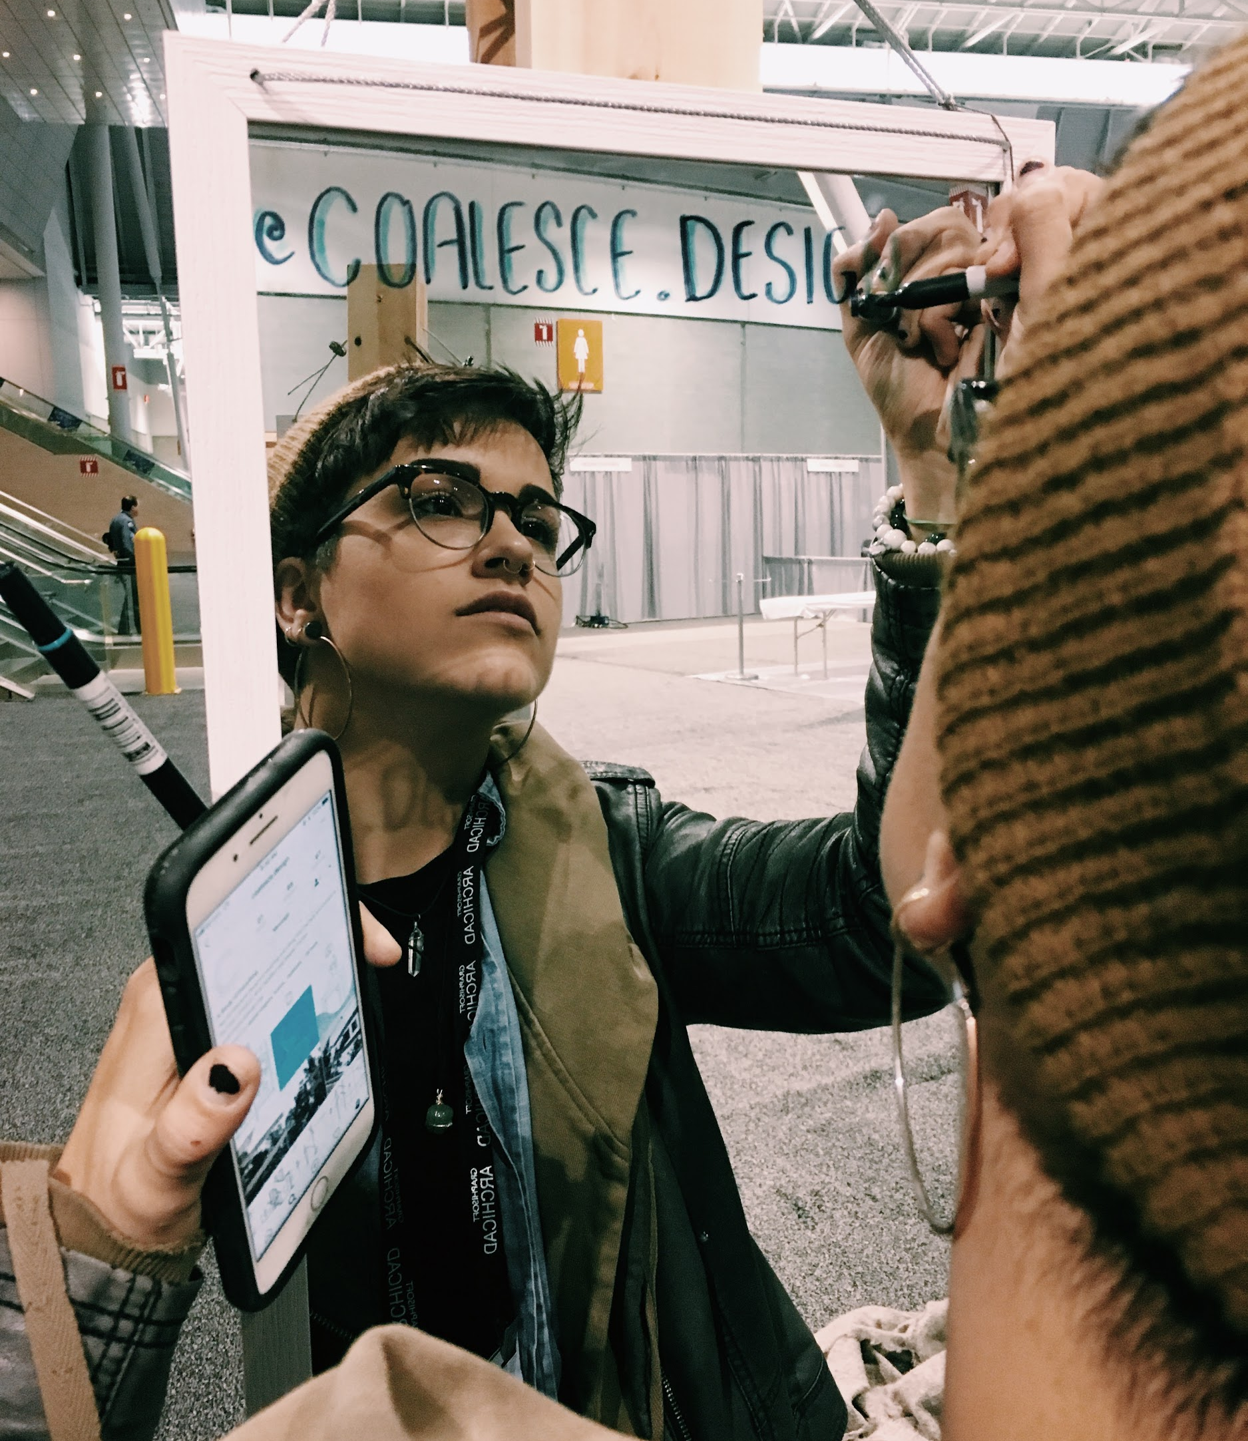
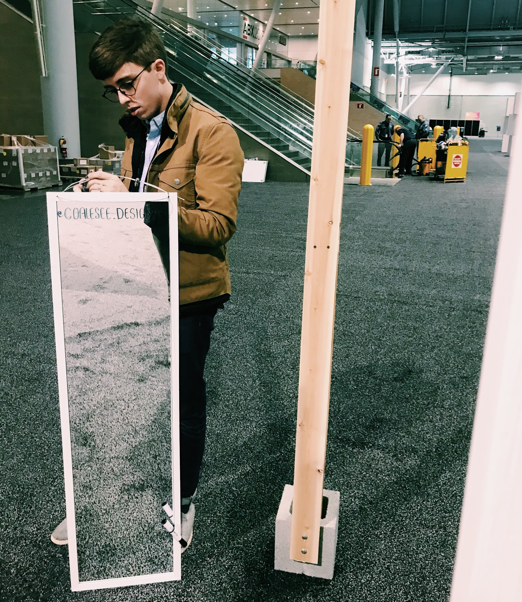

Slide 14
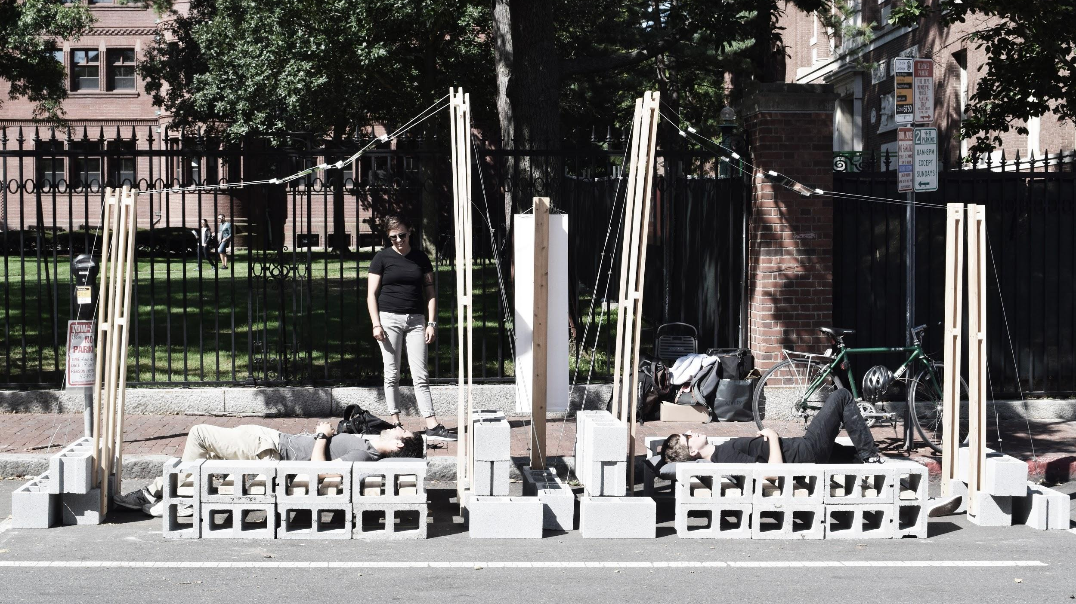

Slide 15
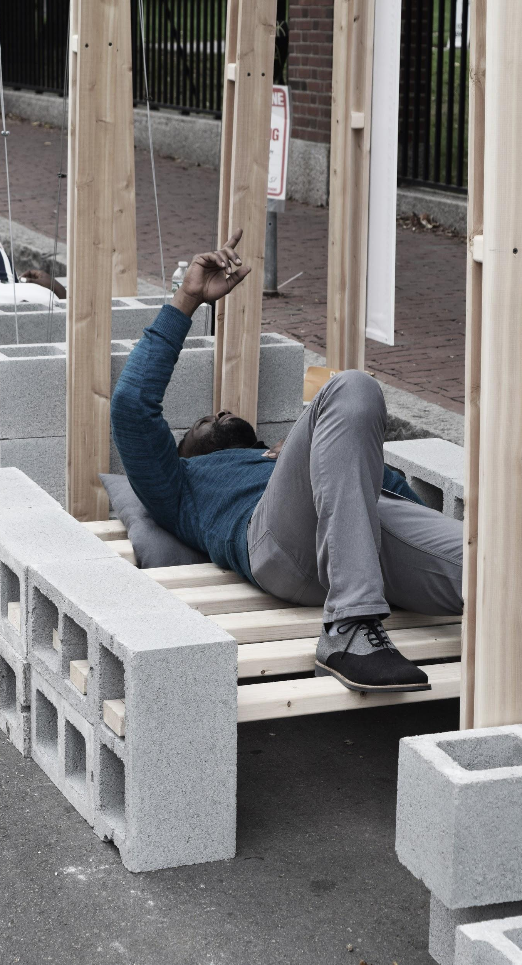
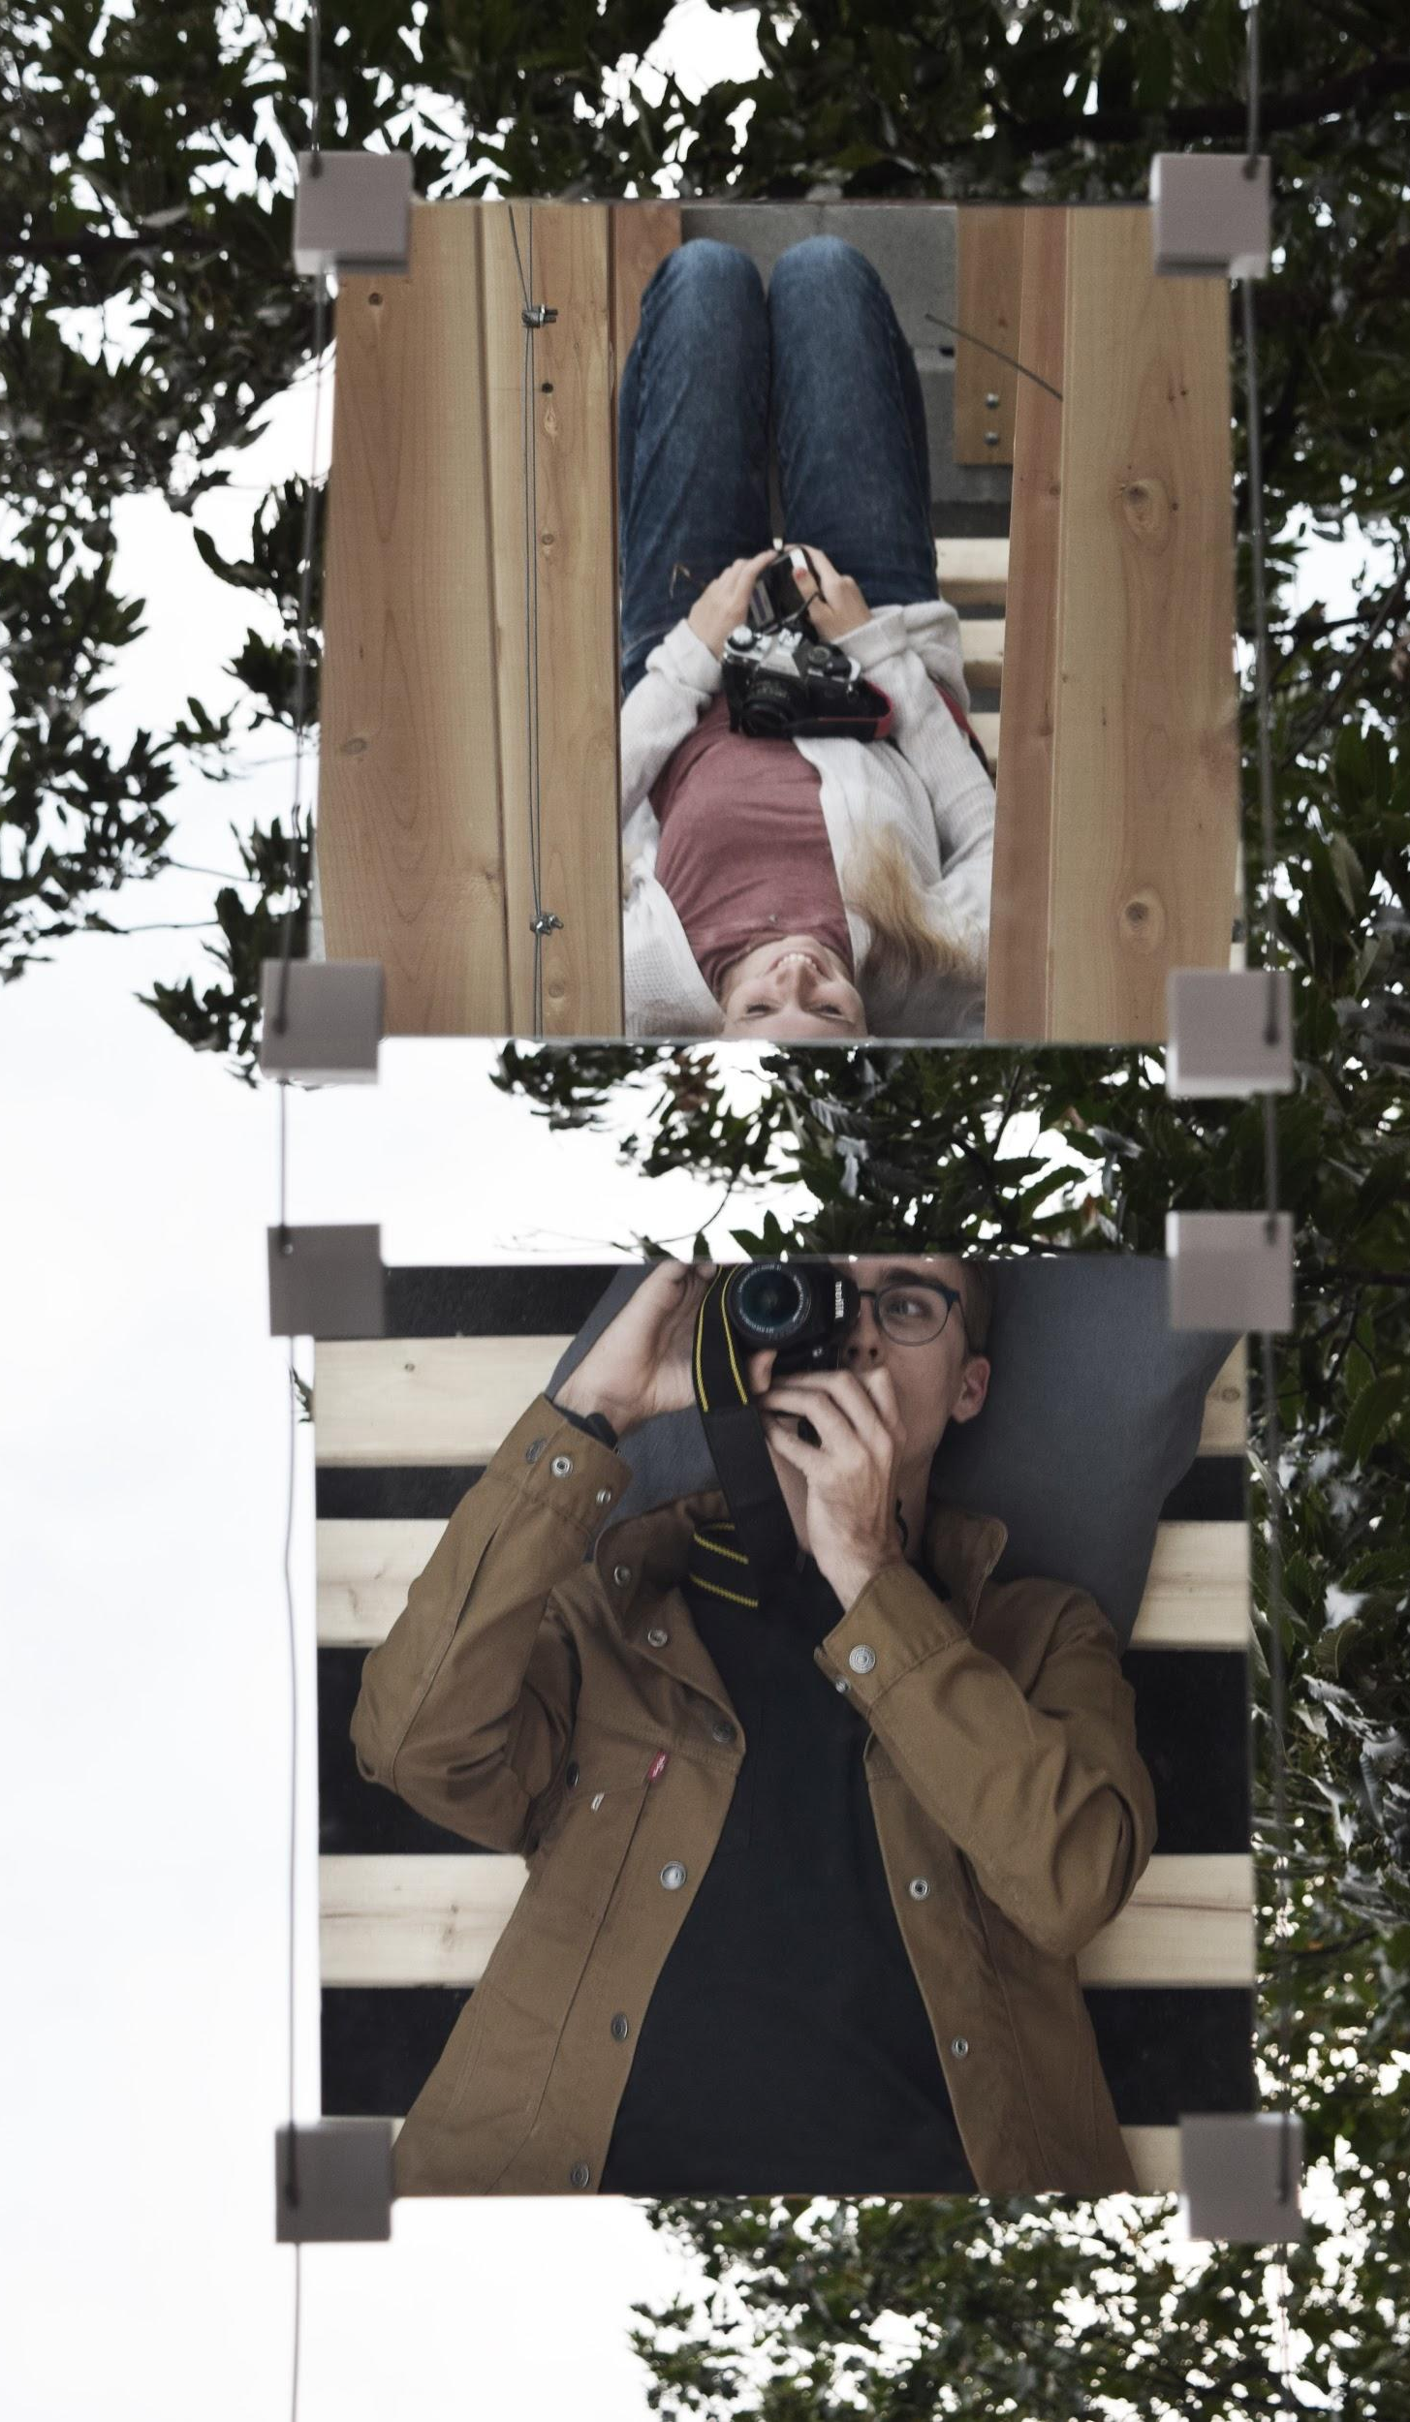
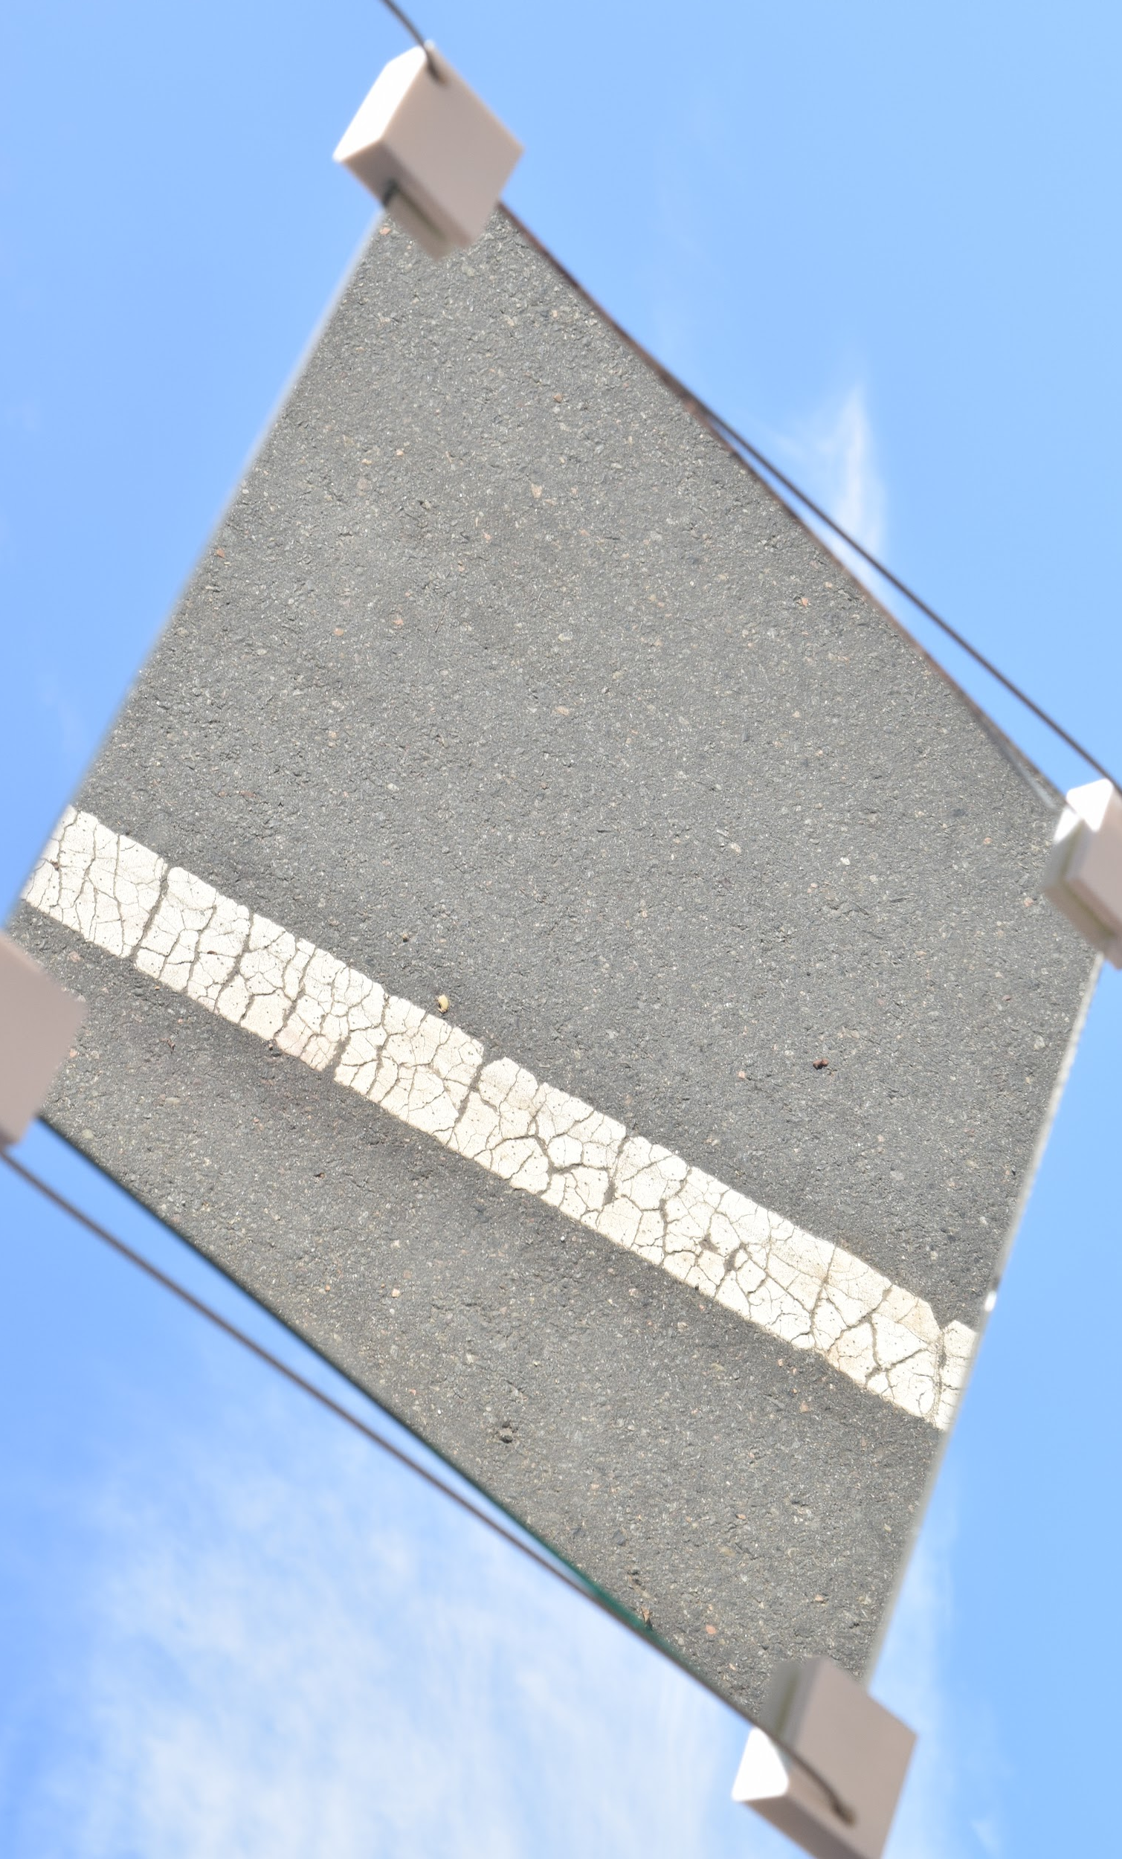

Slide 16
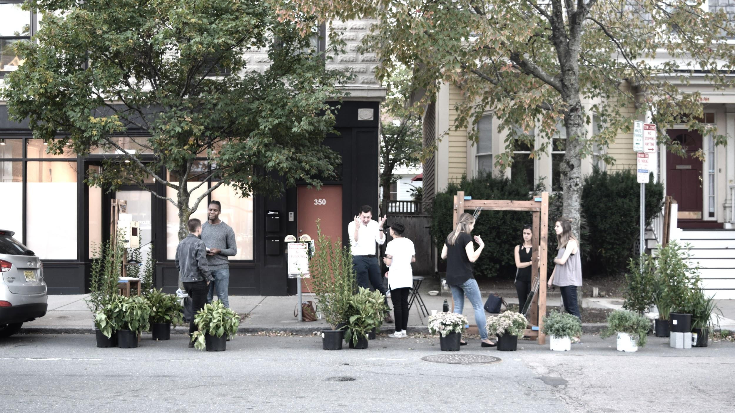

Slide 17
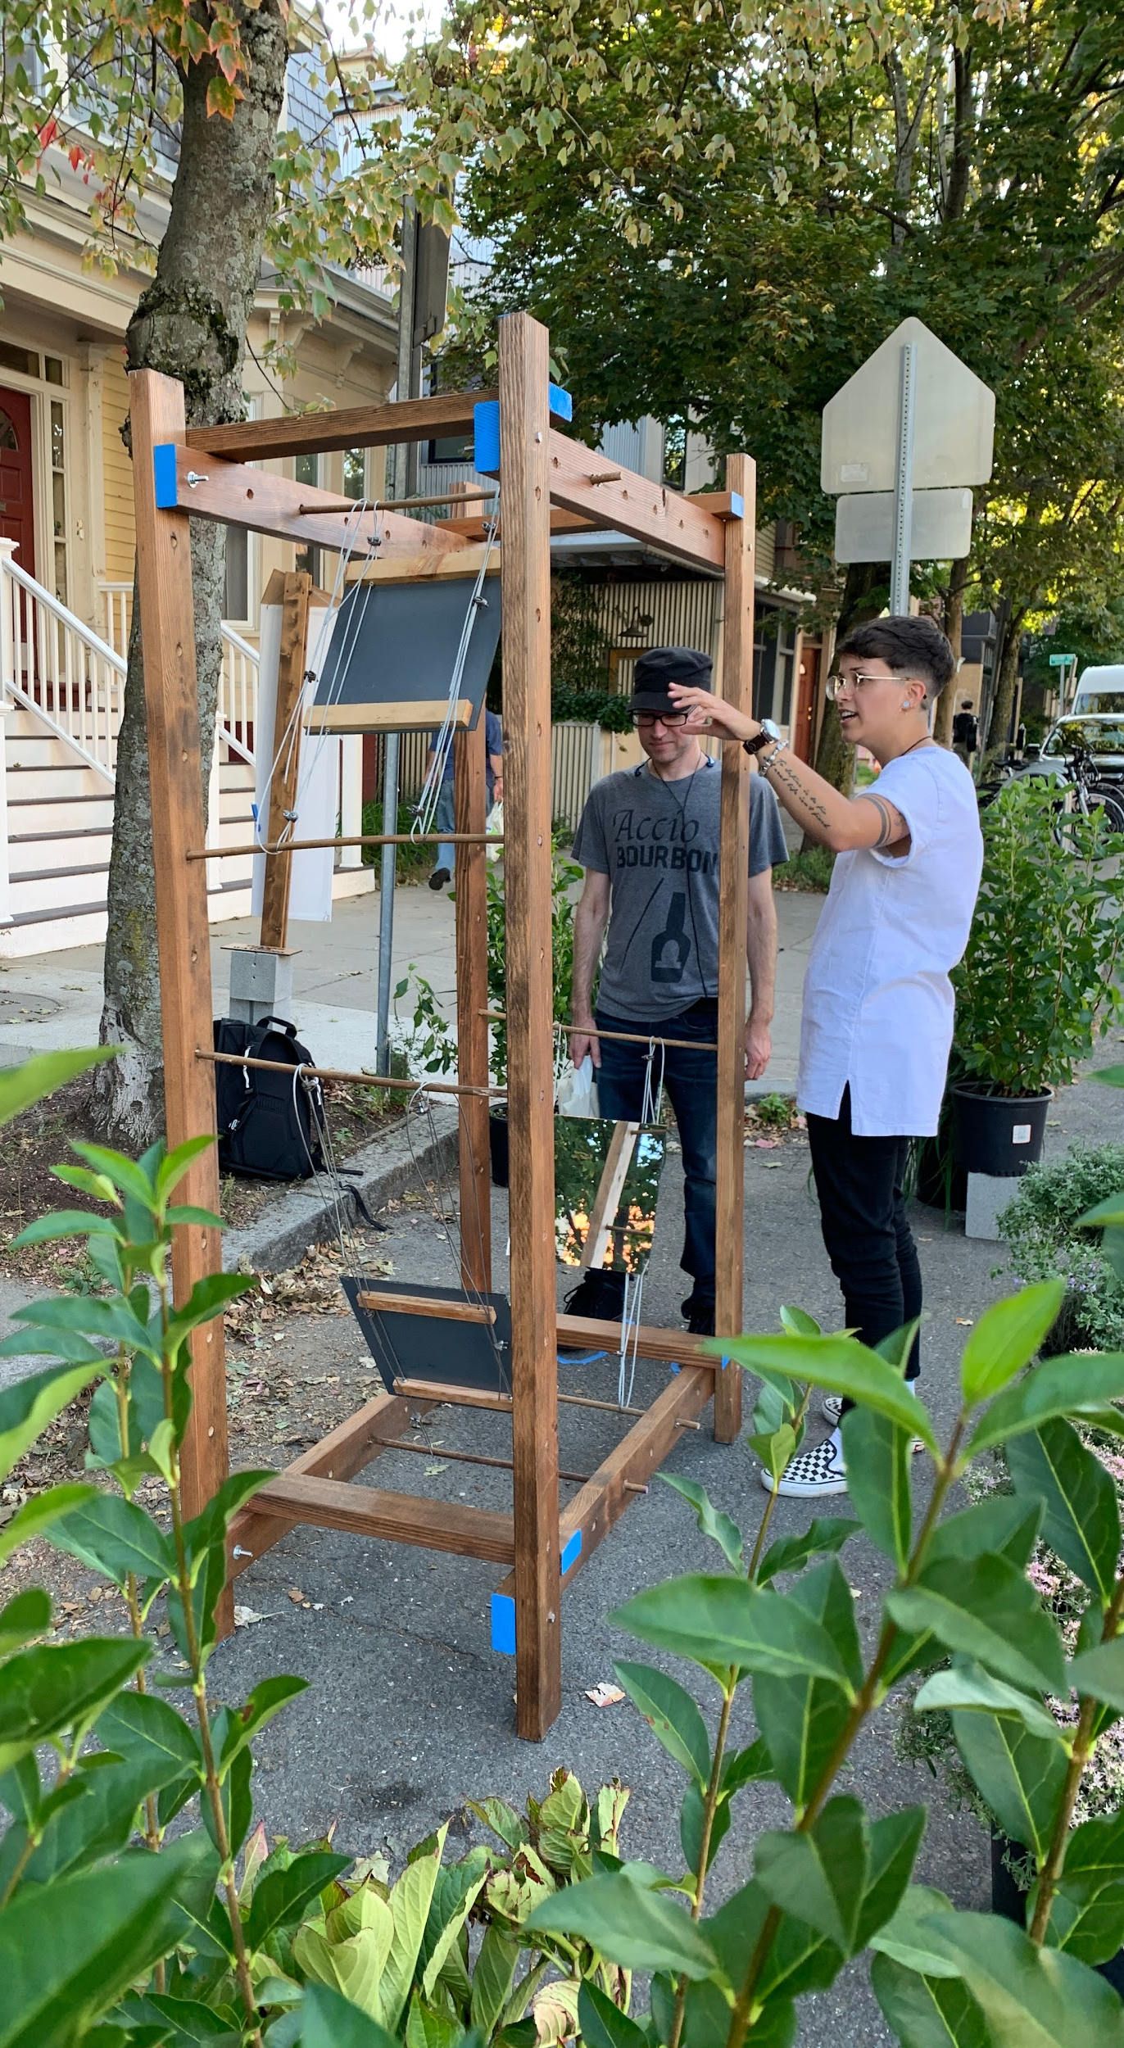
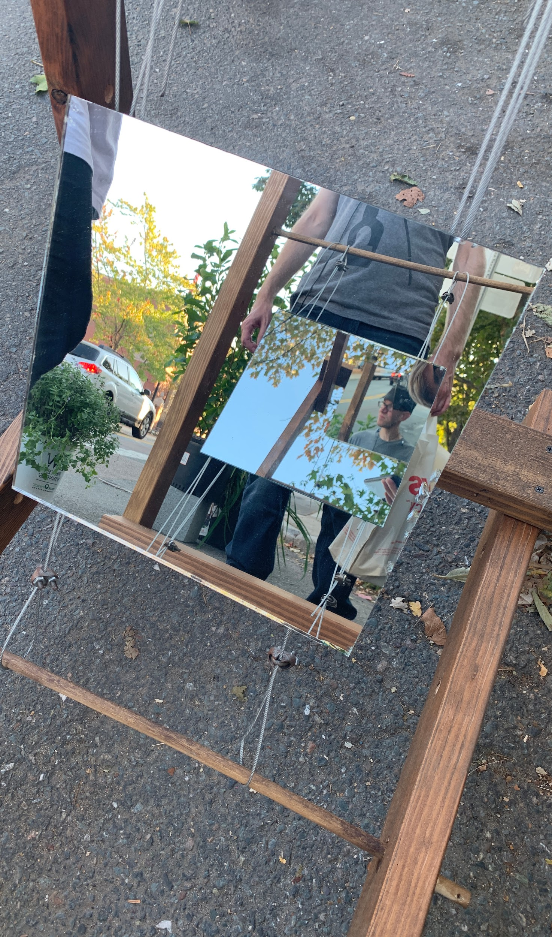
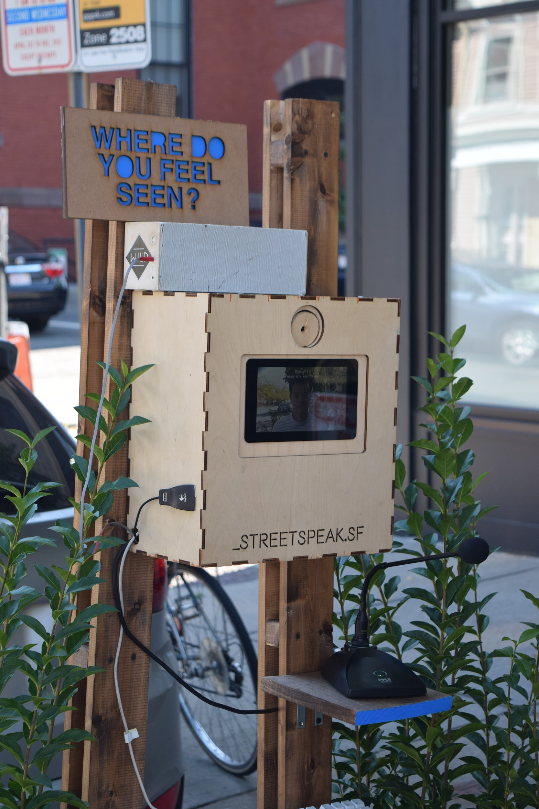

Slide 18
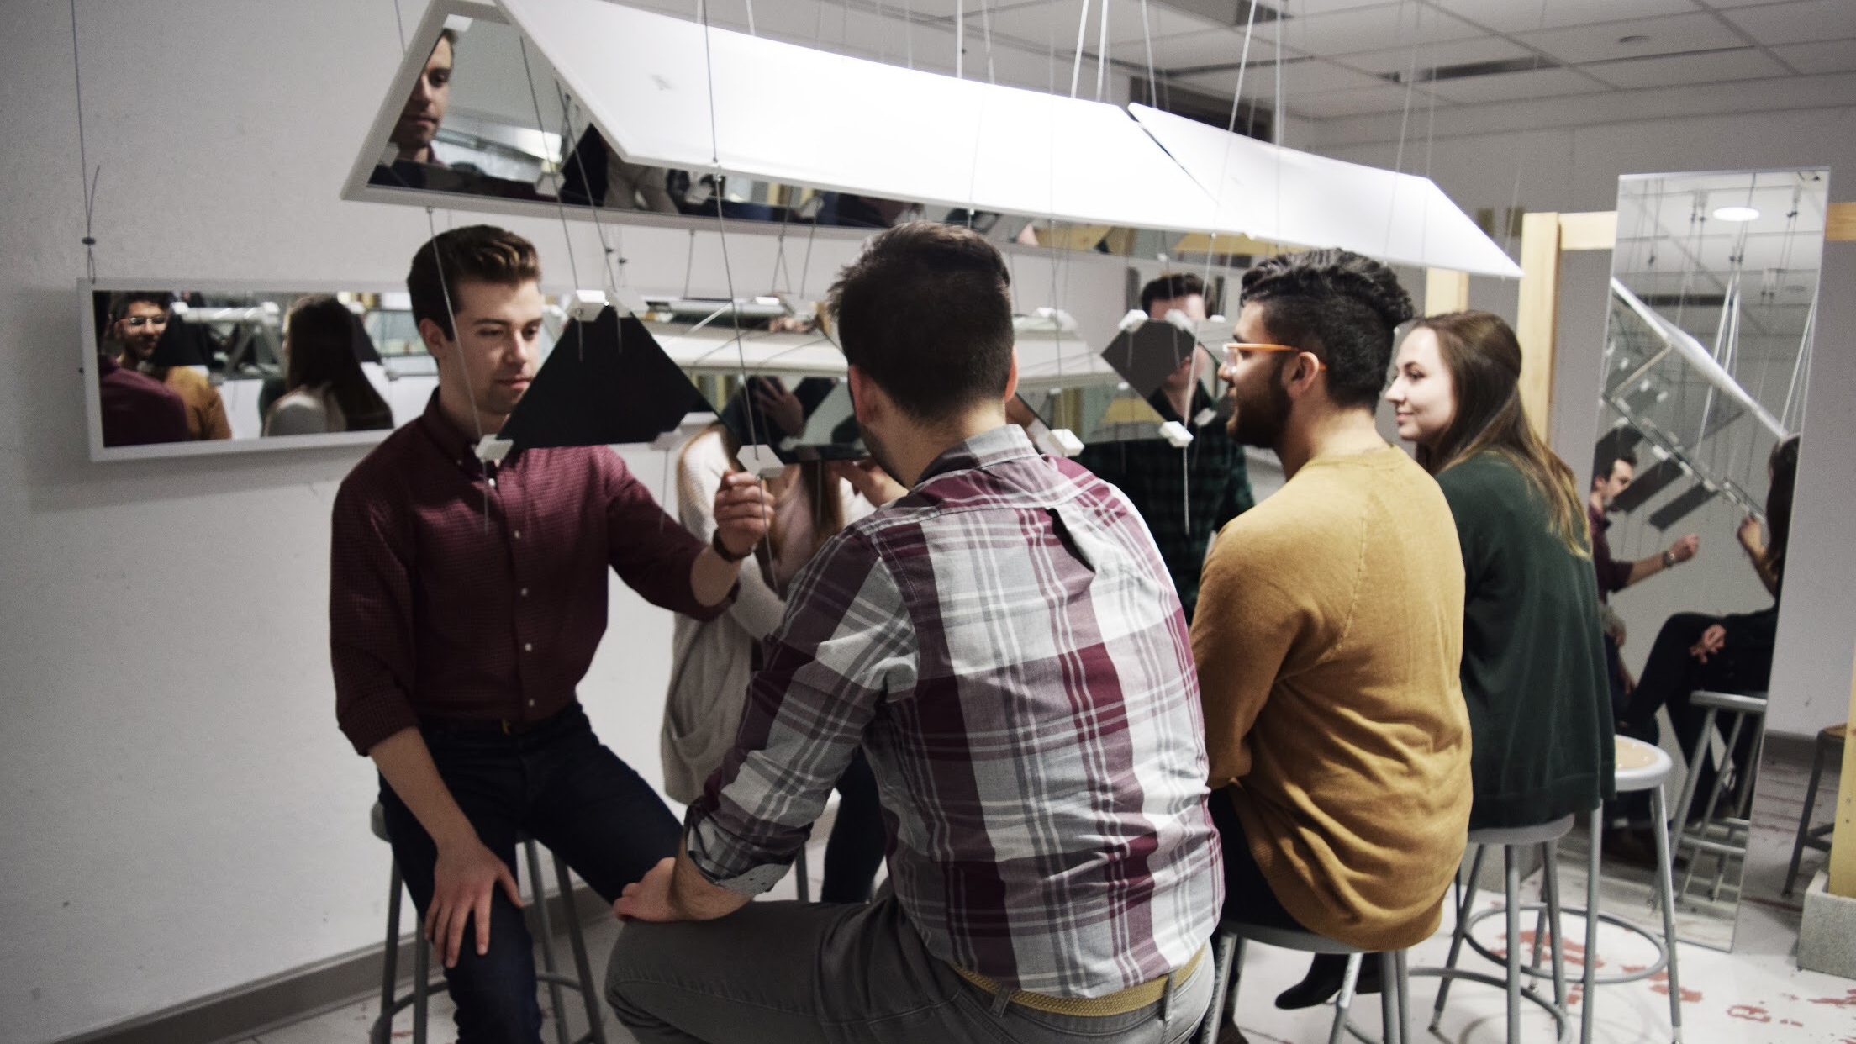

Slide 19
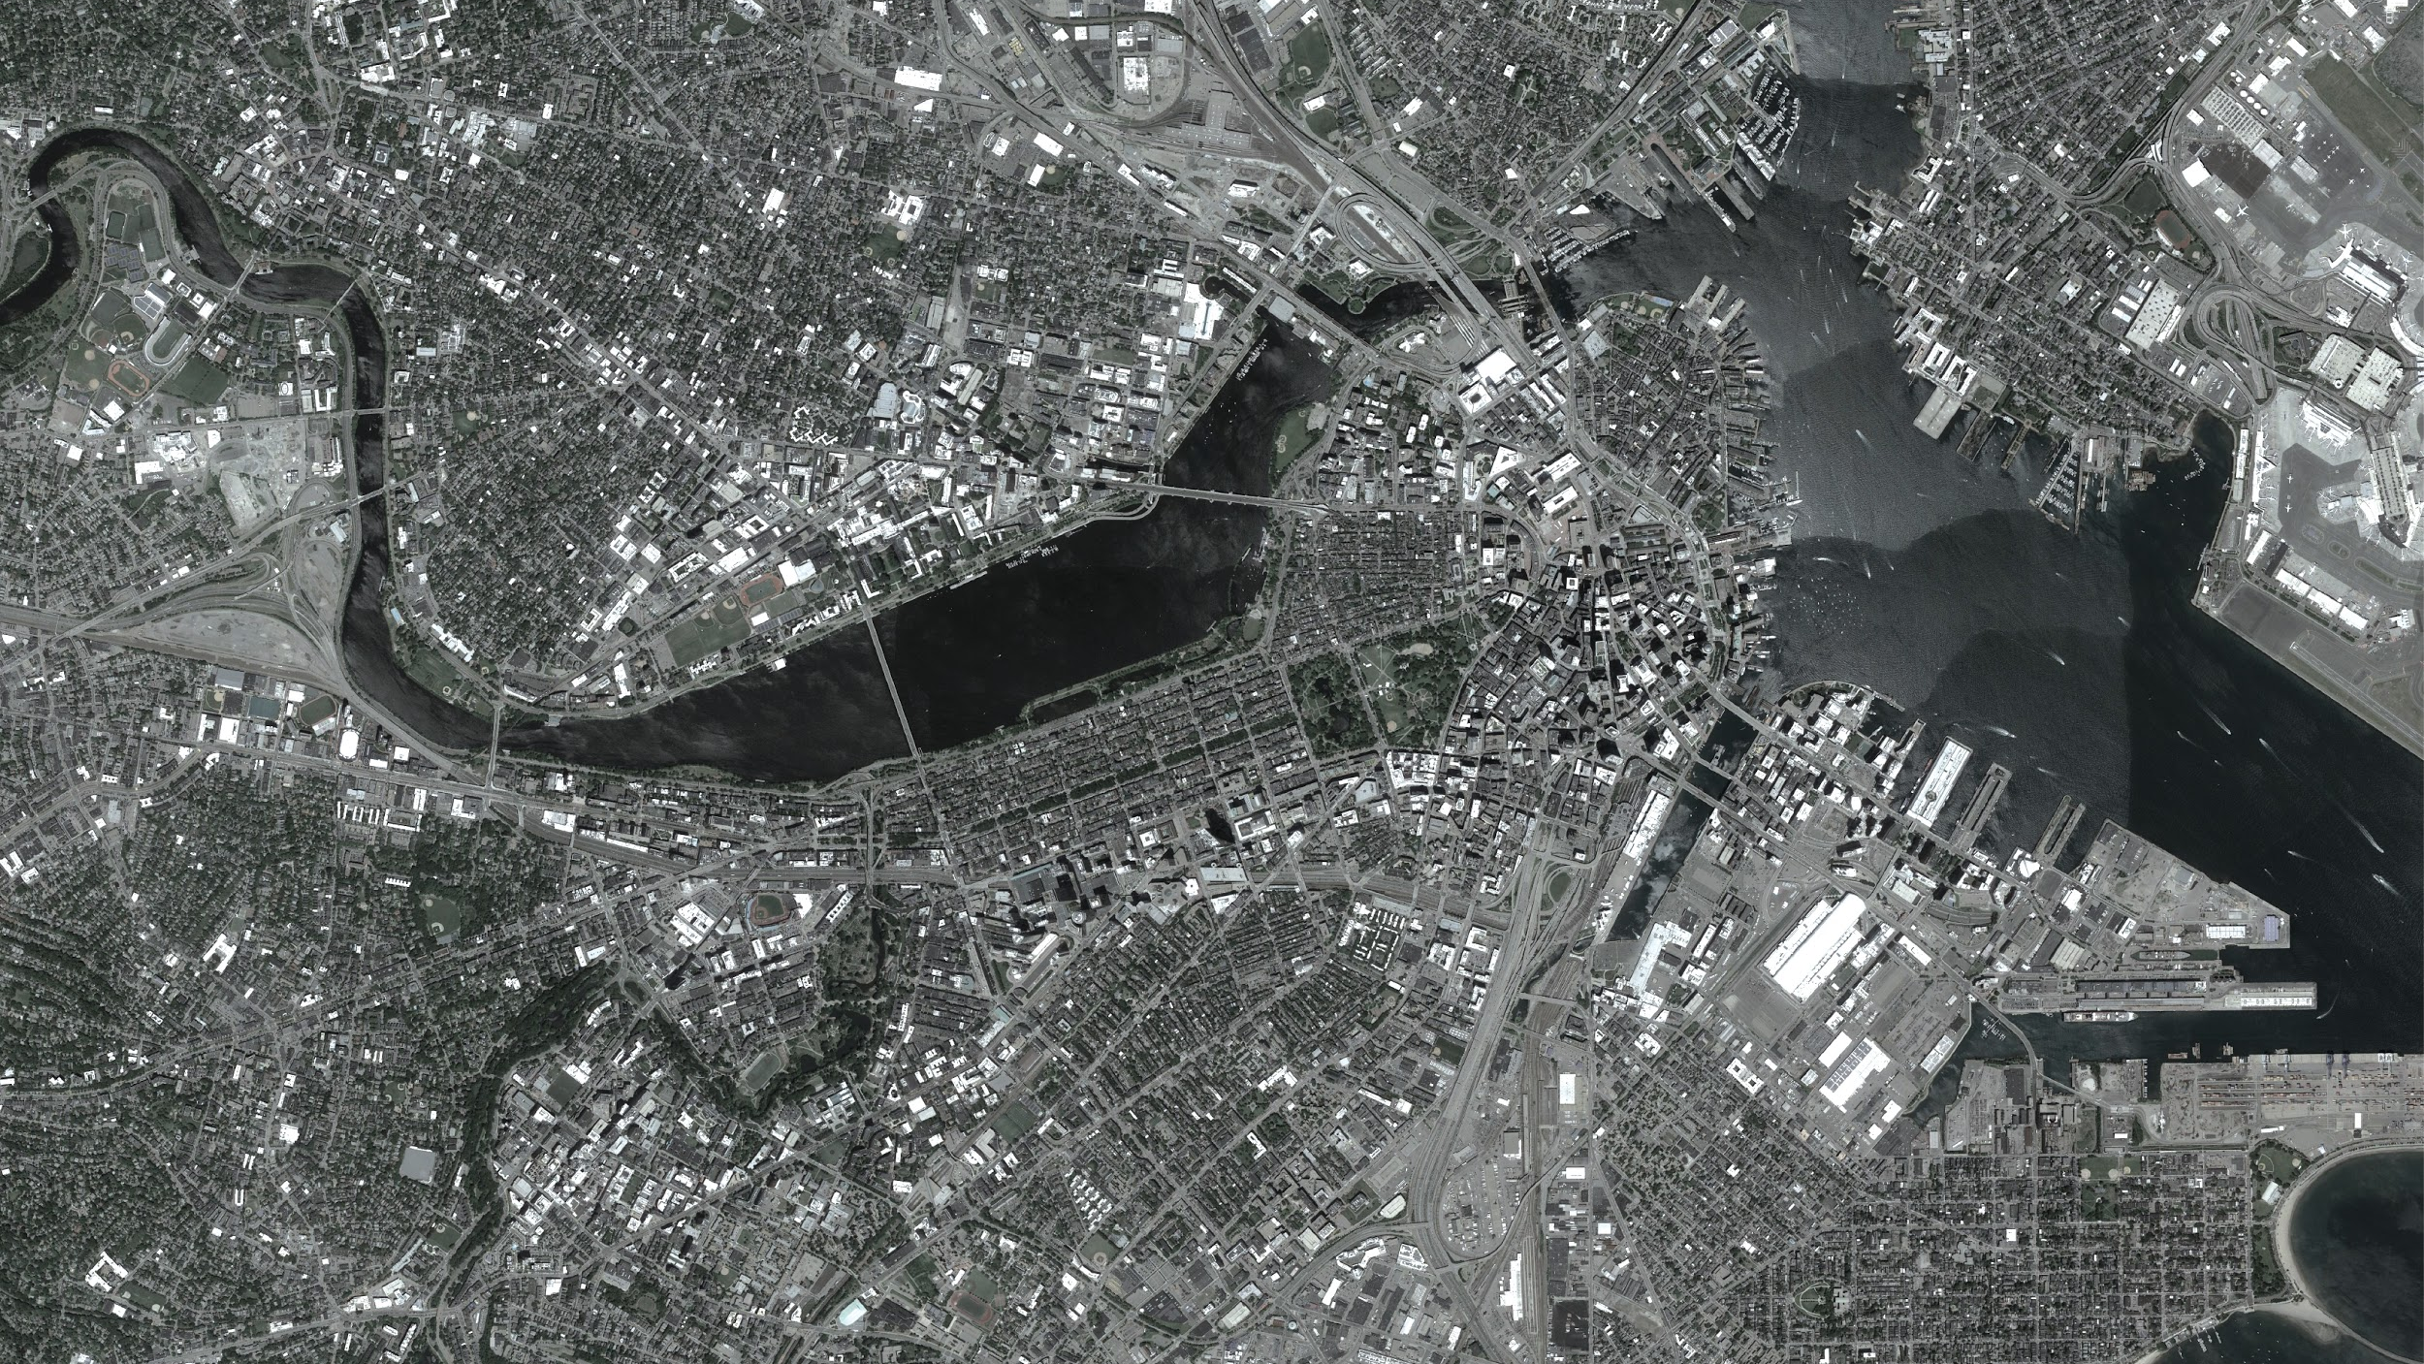

Slide 20
Moving Forward!
Do’s
Dont’s
Wide Variety of Formats
Only One Focus
Season 2
Echo-Chamber
New positioning
Give up!
New engagement
Lose our interest
More collaborations

Slide 21
